Slide 1
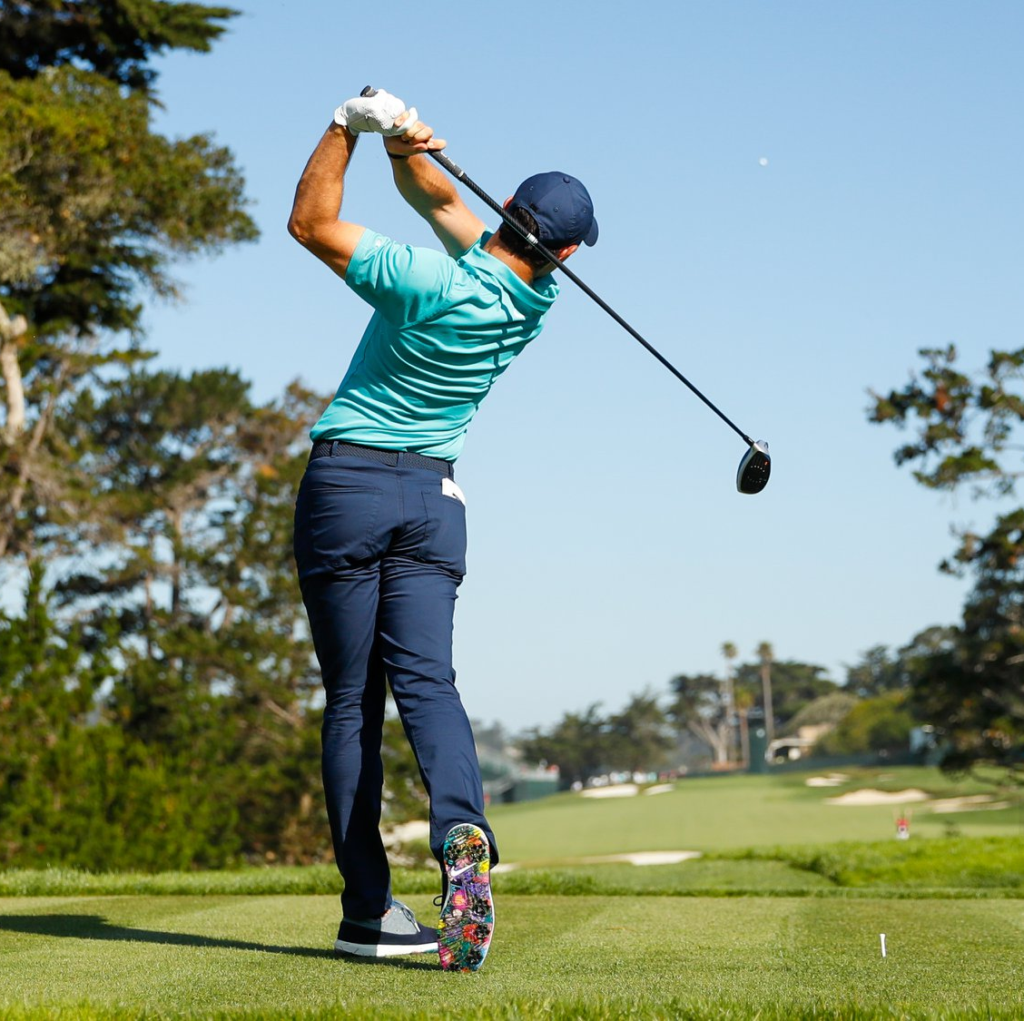
Tee it High, Let it Fly: Exploring the Impact of Distance in Modern Golf
Distance off the tee is believed to give a significant advantage
A closer approach to the hole can lead to better scoring opportunities
Longer shots also carry increased risk, higher chances of encountering hazards

Slide 2
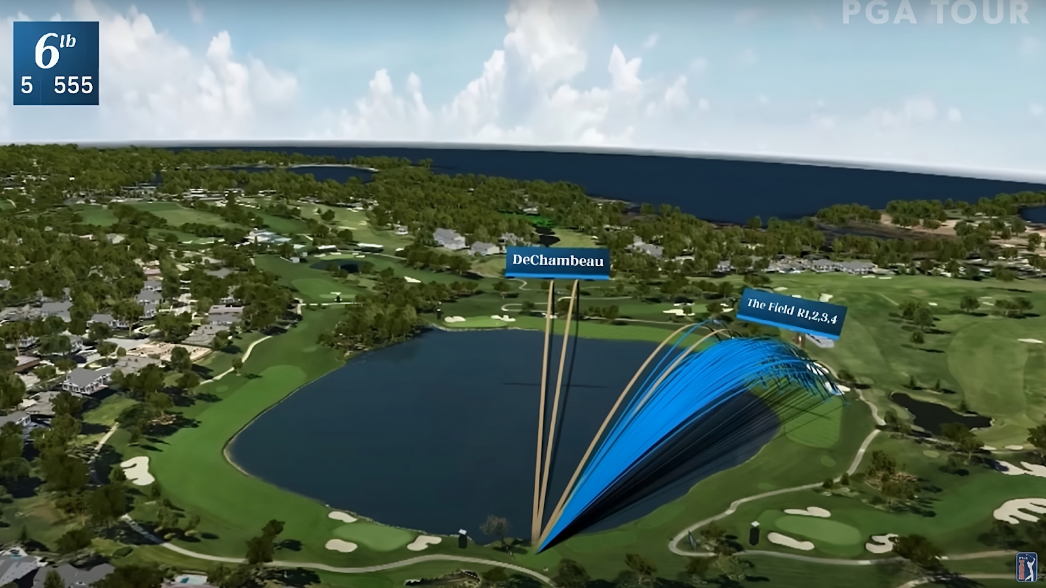
So why is everyone chasing longer drives

Slide 3
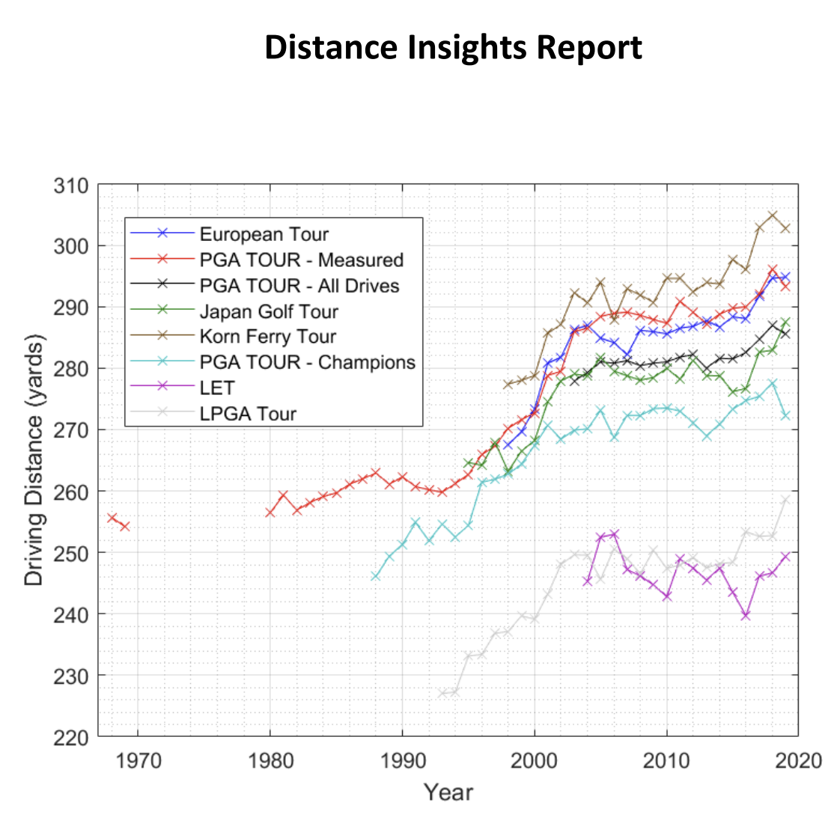
Evolution of Driving Distance
Driving distance in professional golf has significantly increased over time
Key factors contributing to this trend include:
Advancements in equipment technology
Improved player fitness
Optimised swing techniques
The Distance Insights Report (published in 2020 by the USGA and The R&A) examines these historical trends

Slide 4
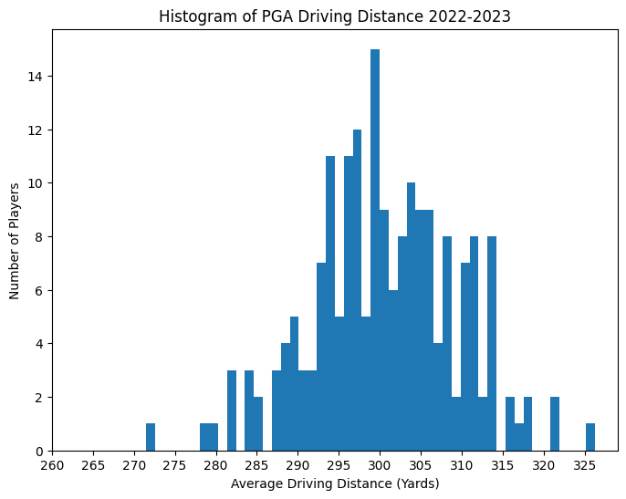
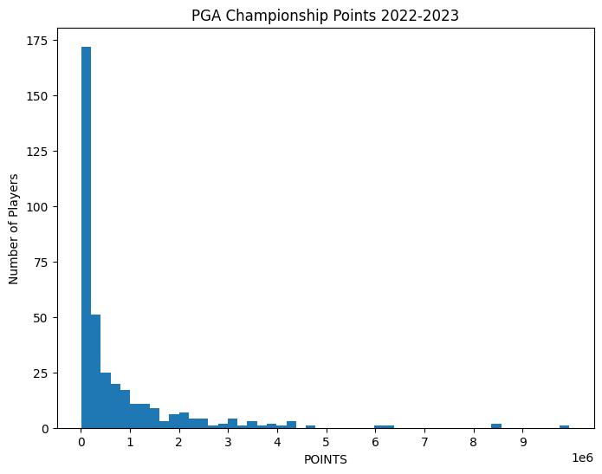
Datasets
Driving Distance
PGA Championship Points

Slide 5
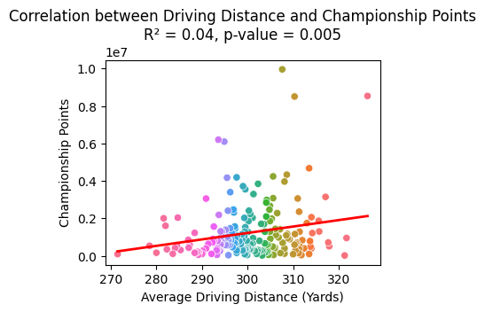
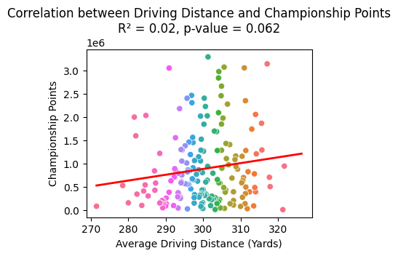
Regression
Linear Regression
Linear Regression (Outliers removed)

Slide 6
Interesting Findings
Drop in R-squared value:
Removing outliers reduces variance, lowering the R-squared value
Outliers, can align with trends and increase the R-squared value (Gives the model variability to explain)
Improvement in P-value:
Lower variability makes it easier to detect statistically significant relationships
However, this doesn’t mean the model is better or more predictive.

Slide 7

TLDR
Driving it far doesn’t guarantee success
Go practice your shortgame

